Slide 1
Python for data science Unlocking Automotive Trends Project
Mentor: Munna Pandey
submitted by: S. Pratheek
Wave number:4777
Batch Number:da374S37

Slide 2
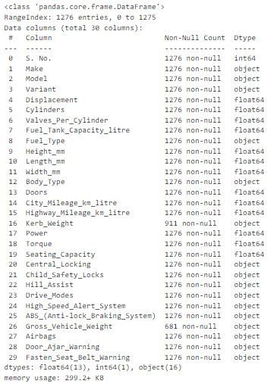
(Sprint9)Data Preprocessing:
import warnings Output:
warnings.filterwarnings('ignore’)
import pandas as pdcars = pd.read_excel(r'DS1_C4_S9_Car_Data.xlsx’)
for col in cars:
if cars[col].isnull().any() and col not in['Kerb_Weight','Gross_Vehicle_Weight']:
if cars[col].dtype == 'object':
cars[col].fillna("Not Available",inplace=True)
elif cars[col].dtype == 'float64':
cars[col].fillna(cars[col].mean(),inplace=True) cars.info()
Interpretation: By using for loop the missing values are filled by mean and mode respective of there data types and by cars.info() we can see all values are filled exculding kerb and gross whicle weight because later we have change there data types

Slide 3
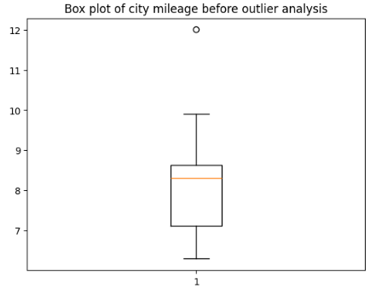
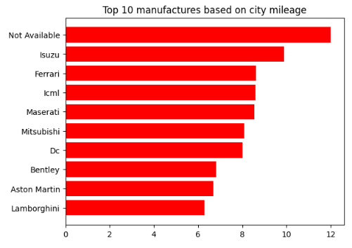
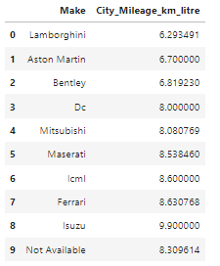
.
Task3:Top 10 cars manufactures based on city mileage and perform outlier analysis
import numpy as np
df=pd.DataFrame(data=fuel_Efficiency.groupby('Make')['City_Mileage_km_litre'].mean().sort_values(ascending=True)[0:10],columns=['City_Mileage_km_litre'])makes = df.groupby('Make')['City_Mileage_km_litre'].mean().sort_values(ascending=True)[0:10].index
values=df.groupby('Make')['City_Mileage_km_litre'].mean().sort_values(ascending=True)[0:10].values
plt.barh(makes,values,color = 'red’) Output:
plt.title('Top 10 manufactures based on
city mileage before outlier analysis’)
plt.show()
plt.boxplot(df['City_Mileage_km_litre'])
plt.title('Box plot of city mileage’)
plt.show()
df=df.reset_index()
df.loc[df['Make']=='Not Available’,
'City_Mileage_km_litre']=8.309614
df
Interpretation:df is created from fuel_efficiency top10 manufactures by
city mileage by matplotlib we compared city mileage by visualizing in horizontal
bargraph.For checking outliers ,i have used boxplot and we found one outlier
from that plot and then ,i replaced the outlier by median value and printed the
data frame df

Slide 4
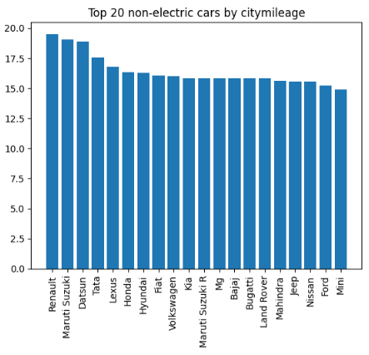
.
Task4:Identify the top 20 non-electric car manufacturers based on city mileage and display the results using a bar graph
df4 =cars.loc[cars['Fuel_Type']!='Electric’]
fuelcars=pd.DataFrame(data=df4.groupby('Make')['City_Mileage_km_litre'].mean().sort_values(ascending=False)[0:20],columns=['City_Mileage_km_litre’])
fuelcars=fuelcars.reset_index()
fuelcarsplt.bar(x = fuelcars['Make'],height = fuelcars['City_Mileage_km_litre’])
plt.title('Top 20 non-electric cars by citymileage’) Output:
plt.xticks(rotation=90)
plt.show()
Interpretation: The above are the top 20 non electric cars based on
City mileage and represented by bar graph

Slide 5
.
Task 5 :Display the car mileages for the following four companies using a pivot table four different pivot tables: Hyundai, Mahindra, Renault, and Skoda
pvt1 = pd.pivot_table(cars,index=['Make'], values=['City_Mileage_km_litre'],aggfunc=['mean’])
pvt1=pvt1[(pvt1.index.get_level_values(0)=='Hyundai')|(pvt1.index.get_level_values(0)=='Mahindra')|(pvt1.index.get_lev el_values(0)=='Renault' )|(pvt1.index.get_level_values(0)=='Skoda’)]
pvt1 = pvt1.reset_index()
print(pvt1)
pvt2 = pd.pivot_table(cars, index=['Make'], values=['City_Mileage_km_litre'],aggfunc=['median’])
pvt2 = pvt2[(pvt2.index.get_level_values(0) == 'Hyundai') | (pvt2.index.get_level_values(0) == 'Mahindra') |(pvt2.index.get_level_values(0)=='Renault')|(pvt2.index.get_level_values(0)=='Skoda’)]
pvt2 =pvt2.reset_index()
print(pvt2)
pvt3 = pd.pivot_table(cars, index=['Make'], values=['Highway_Mileage_km_litre'],aggfunc=['mean’]
)pvt3 = pvt3[(pvt3.index.get_level_values(0) == 'Hyundai') | (pvt3.index.get_level_values(0) == 'Mahindra') |(pvt3.index.get_level_values(0)=='Renault')|(pvt3.index.get_level_values(0)=='Skoda’)]
pvt3=pvt3.reset_index()
print(pvt3)
pvt4 = pd.pivot_table(cars, index=['Make'], values=['Highway_Mileage_km_litre'],aggfunc=['median’])
pvt4 = pvt4[(pvt4.index.get_level_values(0) == 'Hyundai') | (pvt4.index.get_level_values(0) == 'Mahindra') |(pvt4.index.get_level_values(0)=='Renault')|(pvt4.index.get_level_values(0)=='Skoda’)]
pvt4=pvt4.reset_index()
print(pvt4)

Slide 6
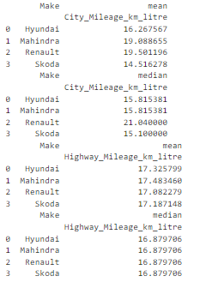
.
Output:
Interpretation:The above are four pivot tables of city and highway mileage of there mean ,median values .The below are the four pivot tables
Task 6:Display the mean and median values of city mileages of the following manufacturers, using a stacked column chart Hyundai, Renault, Mahindra, and Skoda
citycars=pd.pivot_table(cars,index=['Make'],values=['City_Mileage_km_litre'],aggfunc=['mean','median’])
citycars= citycars[(citycars.index.get_level_values(0) == 'Hyundai') | (citycars.index.get_level_values(0) == 'Mahindra')|(citycars.index.get_level_values(0)=='Renault')|(citycars.index.get_level_values(0)=='Skoda')]print(citycars)
citycars.plot(kind = 'bar',stacked=True)
plt.title('Mean median of manufacture by mileage')

Slide 7
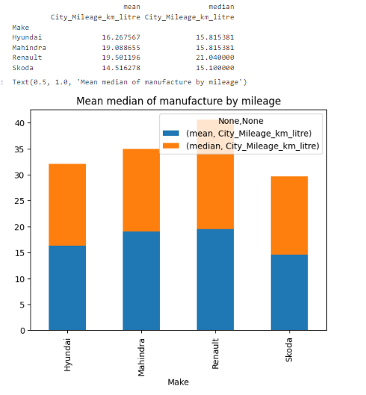
.
Output:
Interpretation: The mean and median of hyundai,mahindra,skoda,renault based on city and highway mileages and the stacked bar graph is used for visualization

Slide 8
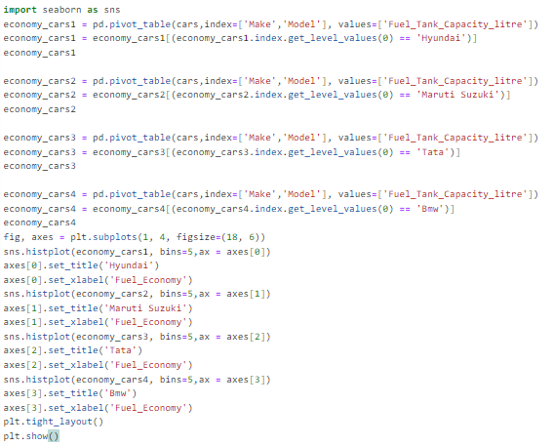
.
Task 9:Analyze the spread of fuel economy using a histogram for all car models of the following manufacturers: Hyundai, Suzuki, Tata, and BMW Which of these manufacturers has the most skewed mileage distribution?
import seaborn as sns
economy_cars1=pd.pivot_table(cars,index=['Make','Model’],values=['Fuel_Tank_Capacity_litre’])
economy_cars1 = economy_cars1[(economy_cars1.index.get_level_values(0) == 'Hyundai’)]
economy_cars1
economy_cars2=pd.pivot_table(cars,index=['Make','Model’],values=['Fuel_Tank_Capacity_litre’])
economy_cars2 = economy_cars2[(economy_cars2.index.get_level_values(0) == 'Maruti Suzuki’)]
economy_cars2
economy_cars3=pd.pivot_table(cars,index=['Make','Model'],values=['Fuel_Tank_Capacity_litre’])
economy_cars3 = economy_cars3[(economy_cars3.index.get_level_values(0) == 'Tata’)]
economy_cars3
economy_cars4 = pd.pivot_table(cars,index=['Make','Model'], values=['Fuel_Tank_Capacity_litre’])
economy_cars4 = economy_cars4[(economy_cars4.index.get_level_values(0) == 'Bmw’)]
economy_cars4
fig, axes = plt.subplots(1, 4, figsize=(18, 6))
sns.histplot(economy_cars1, bins=5,ax = axes[0])
axes[0].set_title('Hyundai’)
axes[0].set_xlabel('Fuel_Economy’)
sns.histplot(economy_cars2, bins=5,ax = axes[1])
axes[1].set_title('Maruti Suzuki’)
axes[1].set_xlabel('Fuel_Economy’)
sns.histplot(economy_cars3, bins=5,ax = axes[2])
axes[2].set_title('Tata’)
axes[2].set_xlabel('Fuel_Economy’)
sns.histplot(economy_cars4, bins=5,ax = axes[3])
axes[3].set_title('Bmw’)
axes[3].set_xlabel('Fuel_Economy’)
plt.tight_layout()
plt.show()

Slide 9
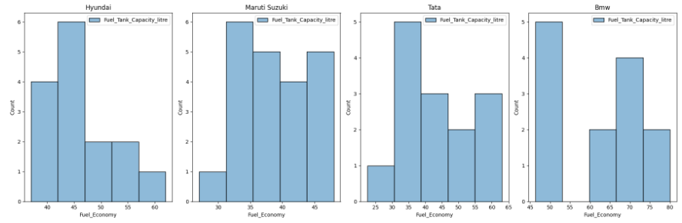
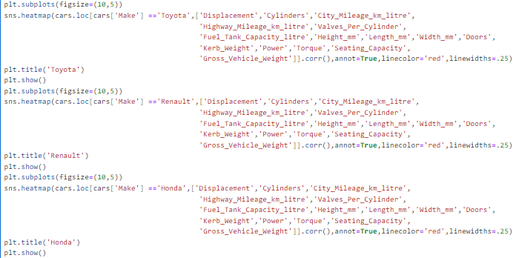
.
Output:
Interpretation: I have used subplots and plotted four histograms using seaborn for all manufactures mentioned in task . By plotting we can see bmw has more skewed than other distribution because the histogram is aside form a group of other fuel efficient
Task 13:Identify at least three features that affect the mileages (using correlation analysis) of cars from the following manufacturers: Renault, Toyota, and Honda Represent them visually using appropriate types of charts/graphs in Python.

Slide 10
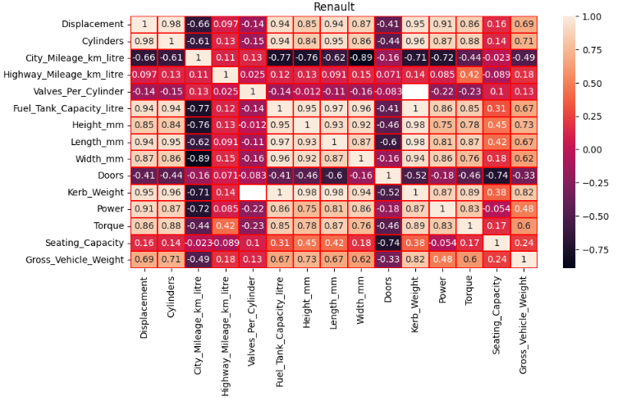
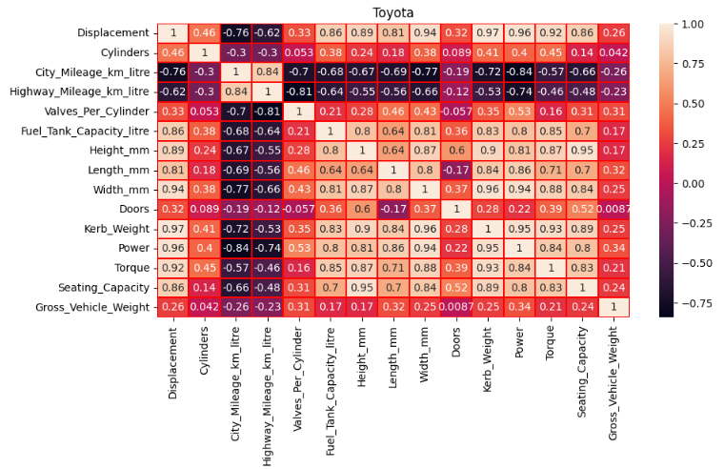
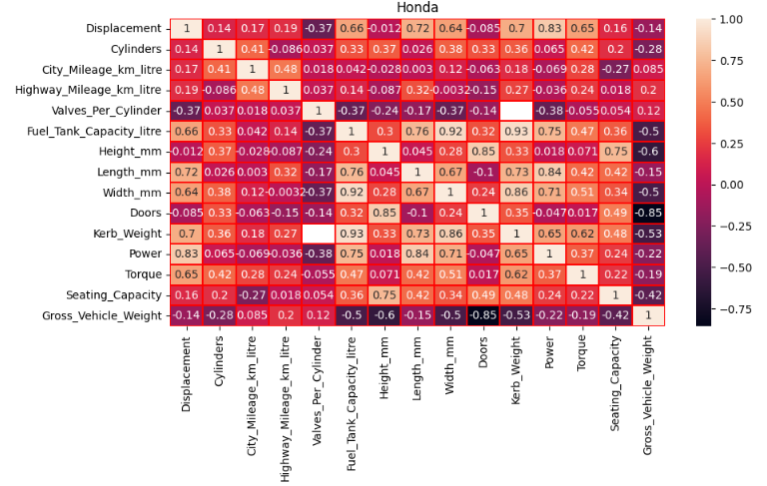
Output:
Interpretation: The below are heat maps of toyota,honda,renault to know correlation between other numeric columns with mileage.
From all heat maps the factors that affect both city and highway mileage are kerbweight,power,displacement etc..

Slide 11
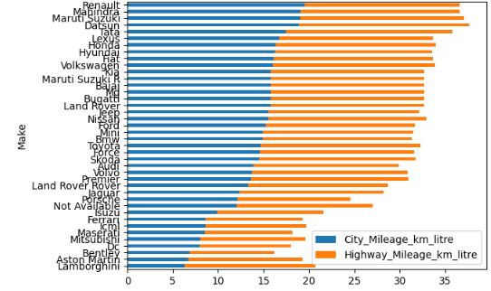
.
Task 7: Display the average mileage (city and highway) of all manufacturers using a horizontal bar chart, in ascending order of mileage.
allcars=pd.pivot_table(cars,index=['Make'],values=['City_Mileage_km_litre','Highway_Mileage_km_litre’])
allcars = allcars.sort_values(by='City_Mileage_km_litre', ascending=True)
allcars.plot(kind='barh',stacked=True)
plt.figure(figsize=(14,8))
Output:
Interpretation:The stacked horizontal bargraph represents average city mileage in ascending order along with manufactures

Slide 12
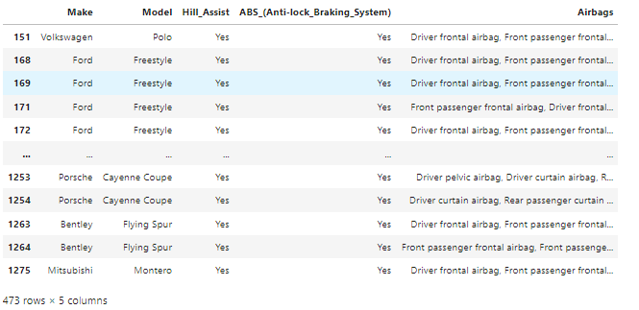
Sprint10:
Task 1: Safety Feature Assessment
Examine the presence of safety features such as ABS, airbags. and hill assist, to assess the safety standards of various car models with respect to each feature mentioned above.
df4 = cars.loc[:,['Make', 'Model','Hill_Assist','ABS_(Anti-lock_Braking_System)','Airbags’]]
safety_cars=pd.DataFrame(df4.loc[(df4['Hill_Assist']!='NotAvailable')&(df4['ABS_(Antilock_Braking_System)']!='NotAvailable')&(df4['Airbags']!='NotAvailable'),['Make','Model','Hill_Assist','ABS_(Antilock_Braking_System)','Airbags’]])
safety_cars
Output:
Interpretation:The cars with safety features are extracted and stored in safety cars with contain above mentioned features

Slide 13
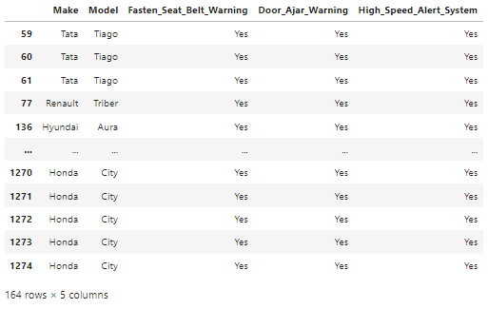
.
Task 3: Alert Systems Analysis Investigate the presence of high-speed alerts, seat belt reminders, and door-ajar warnings to assess the integration of safety and convenience features with respect to each feature mentioned above.
df6=cars.loc[:,['Make','Model','Fasten_Seat_Belt_Warning','Door_Ajar_Warning','High_Speed_Alert_System’]]
safety_cars1 = pd.DataFrame(df6.loc[(df6['Fasten_Seat_Belt_Warning']!='Not Available') & (df6['Door_Ajar_Warning']!='Not Available') &(df6['High_Speed_Alert_System']!='Not Available'),['Make', 'Model','Fasten_Seat_Belt_Warning','Door_Ajar_Warning','High_Speed_Alert_System’]])
Safety_cars1
Output:
Interpretation:The cars with alert system are extracted from cars with features mentioned above and stored in safetycars1

Slide 14
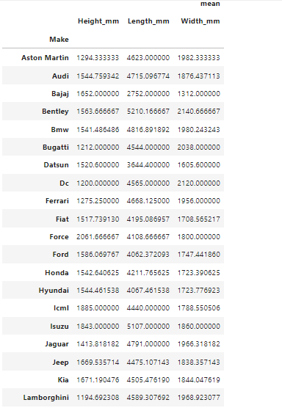
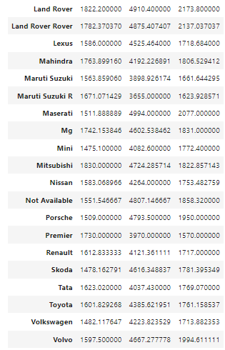
.
Task 4: Dimensional Analysis Analyze the dimensions of cars (height, length, width) to understand size preferences and market demands, aiding in product planning. Also, present make-wise average summaries for all dimensions of cars analyzed above.
dimensions = pd.pivot_table(cars,index=['Make'],values = ['Height_mm', 'Length_mm', 'Width_mm'],aggfunc = ['mean’])
dimensions
Output:
Interpretation: The dimension analysis we can say that the required of a car according to market are 1597.500000,4667.277778,1994.611111

Slide 15
Summary & Conclusion
From Sprint 9 and sprint 10 task we have analyzed the trend in automobile filling missing values
Top 10 car manufactures by city mileage and relation between displacement and mileage by outlier analysis
Most preferred body type in market and most skewed spread of fuel among manufactures
The various factors that affect high way and city mileage
Finding the safety and best features cars like hill assist, seat belt alert etc. in market
Conclusion:
Above project results can be used for any person for better understanding the automobile market trend by which he can get idea which body type and dimension and features should be added to manufacture a car in market or change that needed to be made to existing vehicle in future depending on analysis

